Slide 1
Haskell Adventures
Implementing algorithms through purely functional programming

Slide 2
Compare the programming experience and performance of Haskell with some other standard languages
Essentially
Compare purely functional Haskell solutions with imperative ones

Slide 3


Languages of Choice
Haskell
Python

Slide 4
Build Tools
The ghc compiler is the one used to build all the executable Haskell files
The ghci interpreter is used for demoing live code examples in Haskell, with the standard module, Prelude, already loaded in.

Slide 5
Initial Thoughts
Cool features:
Type Inferencing
Math-styled List Comprehension
Dynamic Dispatch
Errors caught before compiling begins

Slide 6
Initial Thoughts
As with most functional languages, everything in Haskell is (immutable) data and can be treated as such.
Normally a function’s type signature is like this:
But this is optional to use unless there is ambiguity. Otherwise the compiler can inference the type of any piece of data based on how it is used.
Binary Search implementation in Haskell has good example of type inferencing.
Cool features:
Type Inferencing
Math-styled List Comprehension
Dynamic Dispatch
Errors caught before compiling begins

Slide 7
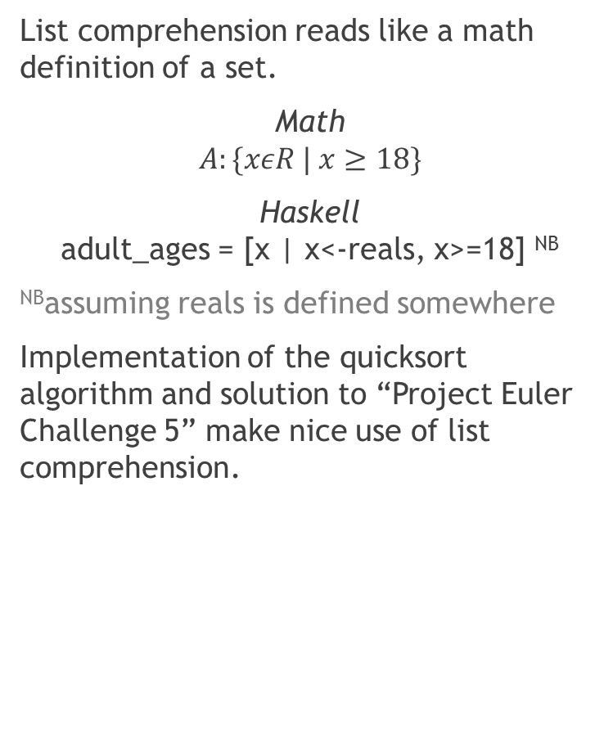
Initial Thoughts
List comprehension reads like a math definition of a set.
Math
$$A:\{xεR | x≥18\}$$
Haskell adult_ages = [x | x<-reals, x>=18] ^{NB}
^{NB}assuming reals is defined somewhere
Implementation of the quicksort algorithm and solution to “Project Euler Challenge 5” make nice use of list comprehension.
Cool features:
Type Inferencing
Math-styled List Comprehension
Dynamic Dispatch
Errors caught before compiling begins

Slide 8
Initial Thoughts
Haskell supports “dynamic dispatch” (pattern matching functions) without any special structure or syntax.
Just type the argument list for each kind of dispatch you want and it will automatically select the correct implementation of the function.
say x = print “This is a number.” say x y = print “Those are my favourites!”
Since all functions are curried in Haskell, any function can be bound to a symbol even if only partially applied.
The Project Euler solution is a good example of this.
Cool features:
Type Inferencing
Math-styled List Comprehension
Dynamic Dispatch
Errors caught before compiling begins

Slide 9
Initial Thoughts
The ghc compiler will not even begin to compile the code unless there are no errors. Saves time and resources.
Cool features:
Type Inferencing
Math-styled List Comprehension
Dynamic Dispatch
Errors caught before compiling begins

Slide 10
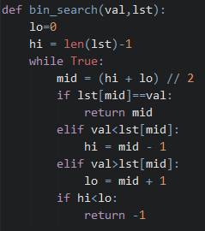
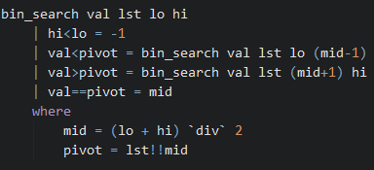
Binary Search
Haskell
Python

Slide 11
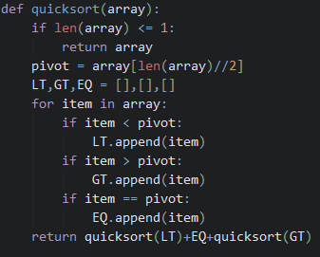
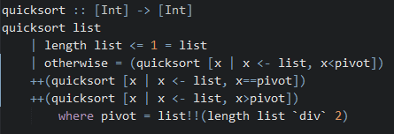
Quick Sort
Haskell
Python
Sort a reversed list of 1000: 36.71μs
Sort a reversed list of 1000: 1732μs

Slide 12
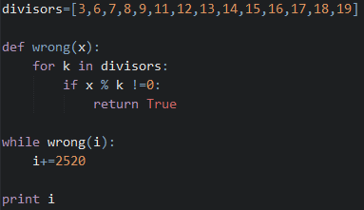
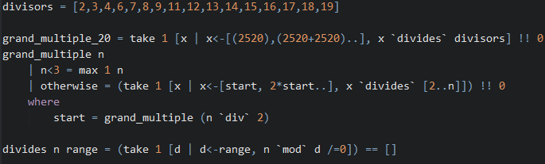
Project Euler: Challenge 5
Haskell
Python

